Slide 1
Efficient Merging and Construction of Evolutionary Trees
Andrzej Lingas,Hans Olsson , and Anna Ostlin
Journal of Algorithms 2001
Reporter: Jian-Fu Dong
(Dong Jian-Fu)

Slide 2
Abstract
In this paper we study the algorithmic problem of constructing rooted evolutionary trees in the so-called experiment model. This model was first presented by Kannan, Lawler, and Warnow(J. Algorithms 21(1996) ). We present a new technique of efficiently merging partial evolutionary trees in this model. We show that two partial evolutionary trees for disjoint set of species can be merged using experiments in time O(dn), where n is the total number of species in the resulting evolutionary tree and d is its maximum degree. We prove our upper time bound on merging evolutionary tees to be asymptotically optimal. By applying our algorithm for merging evolutionary trees we obtain an O(dn log n) time bound on the problem of constructing an evolutionary tree for n species and maximum degree d from experiments. The classic O(n log n) time bound on sorting in the comparison-based model can be seen as a very special case of this upper bound

Slide 3
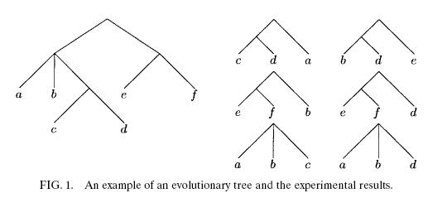
Evolutionary Tree
An evolutionary tree is a tree where the leaves represent species and internal nodes represent their common ancestors.

Slide 4
Some definition
Given a subset S of leaves of T, the partial eolutionary tree induced by S, denoted by
T || S, is defined as the tree obtained by taking the minimum subtree of T connecting the species in S, and then contracting any degree 1 nodes in this subtree. For a partial evolutionary tree U, the set of its leaves will
be denoted by S

Slide 5
Problem definition
The problem of merging two partial eolutionary trees L and R, where S_{L}∩S_{R}=ψ, consists of constructing the partial evolutionary tree T || (S_{L}∪S_{R}), denoted by
L ∪ R, using L, R, and access to an experiment oracle for triples (S_{L}∪S_{R})³

Slide 6
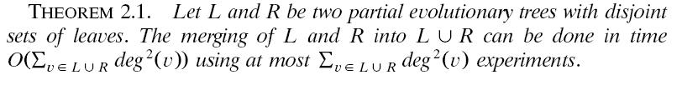
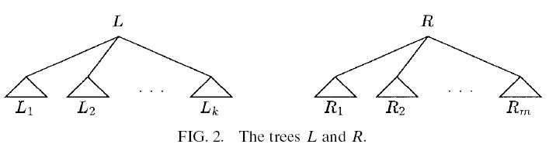
Theorem

Slide 7
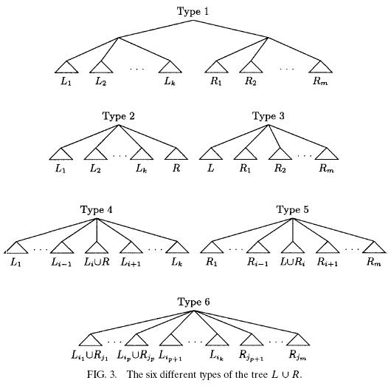

Slide 8

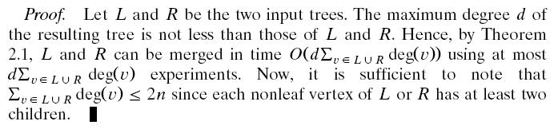
Theorm/Proof(2)

Slide 9
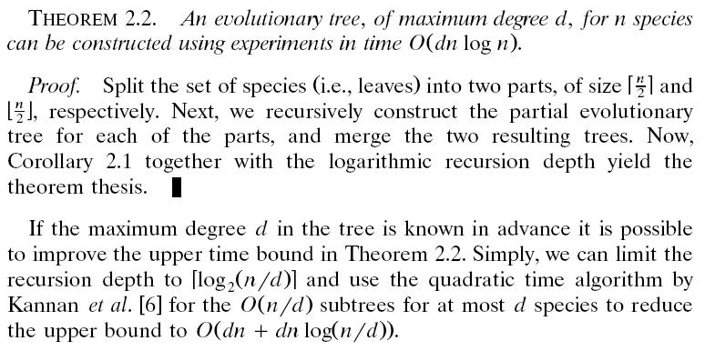
Theorem/proof(3)

Slide 10
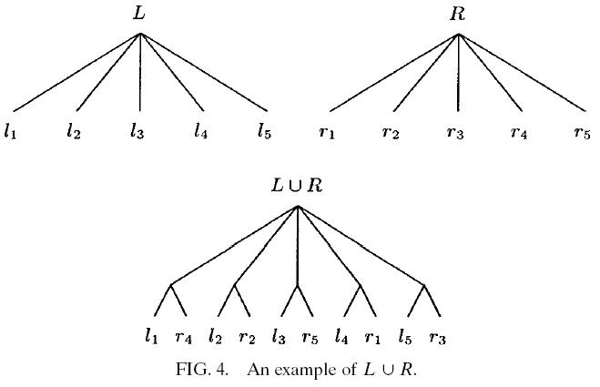
Lower bound on merging trees

Slide 11

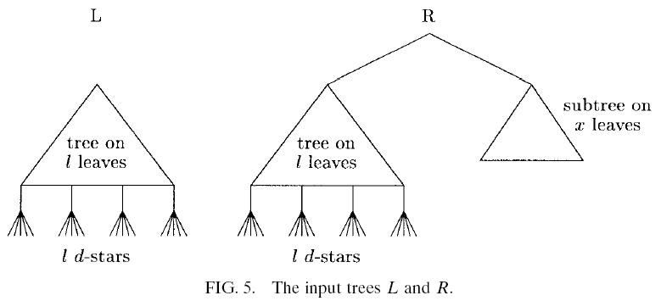
Lower bound on merging trees(2)

Slide 12
Conclusion
As abstract, and it is an intriguing open problem whether one could establish a lower bound on the number of experiments for the evolutionary tree construction problem that would be superlinear in nd for d =O( n / log n)

